Slide 1
Peoplesoft on Exadata
By: Karl Arao
Notes:
Initial draft by: Karl Arao
Workload data: Global Property Management Company

Slide 2
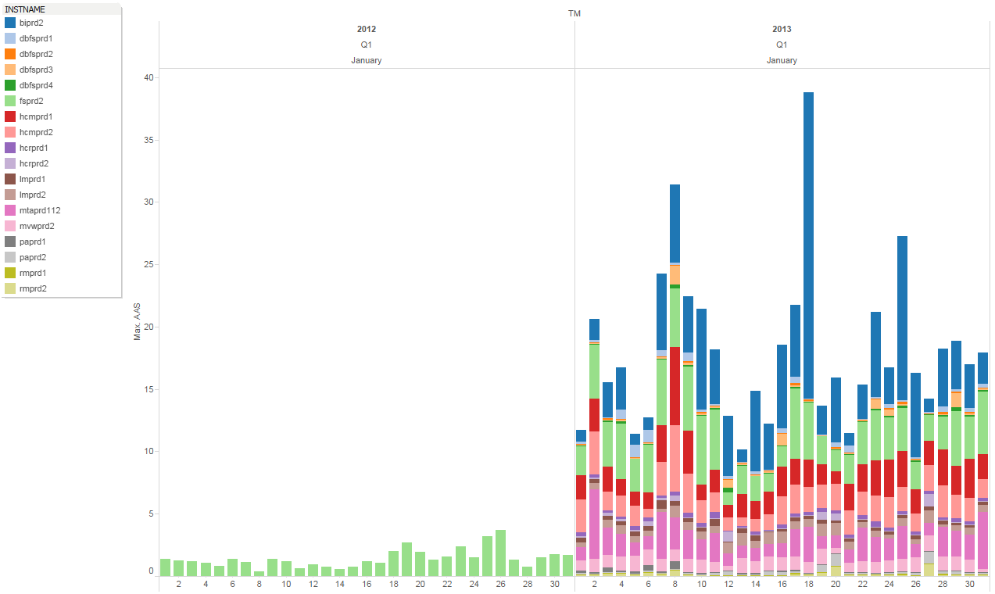
Peoplesoft environment 1 year later
Consolidate and Scale:
Consolidate for better hardware utilization
Scale across nodes as the workload grow. It’s also easy to extend or add capacity.

Slide 3
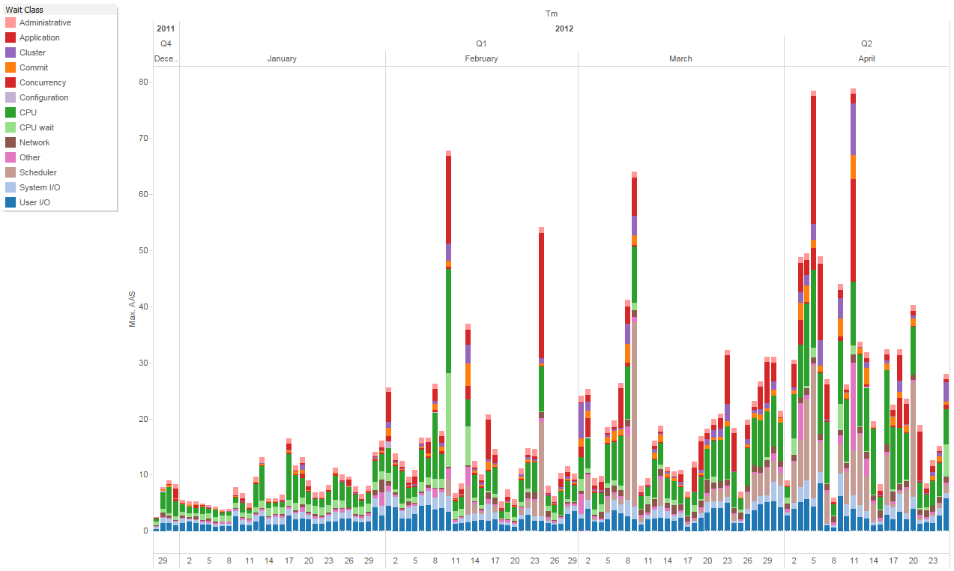
Workload
Common wait events:
CPU, CPU wait, Scheduler
enq: TX – row lock contention
User IO: single block read, smart scan, Direct Path Read, Direct Path Write Temp, Read by other session
System IO: db file parallel write, log file parallel write
Notes:
This is the cluster level workload from January to April

Slide 4
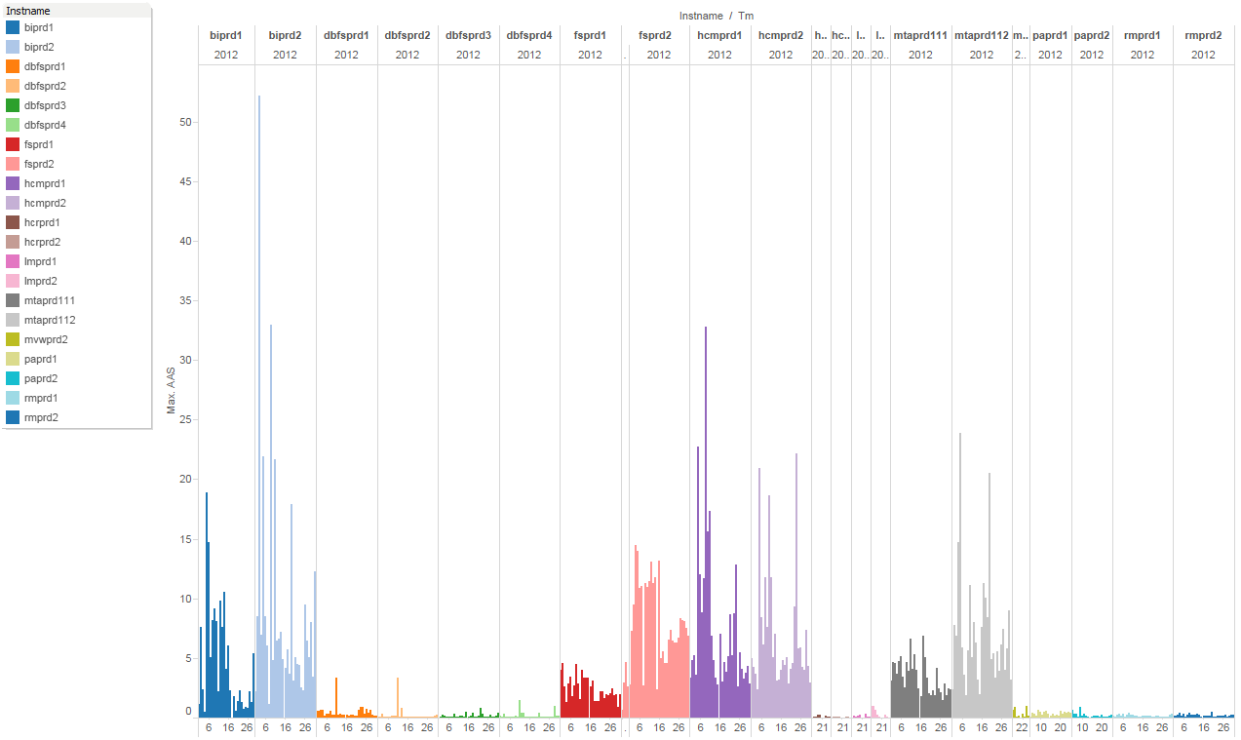
High Load Databases
High Load Databases/Modules:
FS
HCM
MTA
In-house BI/DW
Notes:
This is another view of the workload by database, this shows that usually the high load modules are FS, HCM, MTA.
Also Peoplesoft has built-in reporting functionalities but companies still pull data across various Peoplesoft databases and consolidate them in a full blown DW database.
The Exadata serves as both the consolidation and reporting platform.

Slide 5
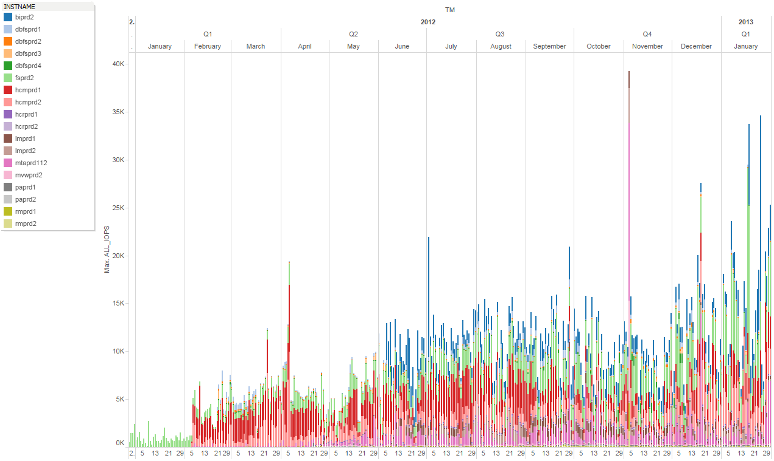
High IOPS and Bandwidth Capacity
Notes:
Exadata IO is just dedicated to Peoplesoft and doesn’t share with other external subsystems.
Even this was on X2 and only flash logging was available at that time (no WBFC yet), once we have configured IORM the IO issues are gone.

Slide 6
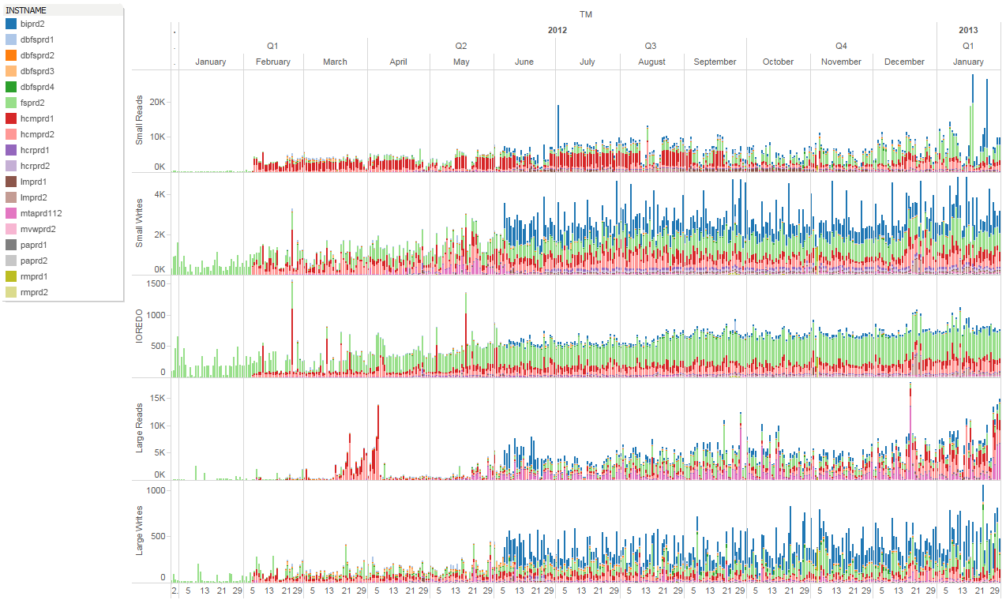
IO Breakdown
Notes:
Peoplesoft can take advantage of high IOPS and high bandwidth capacity of Exadata.

Slide 7
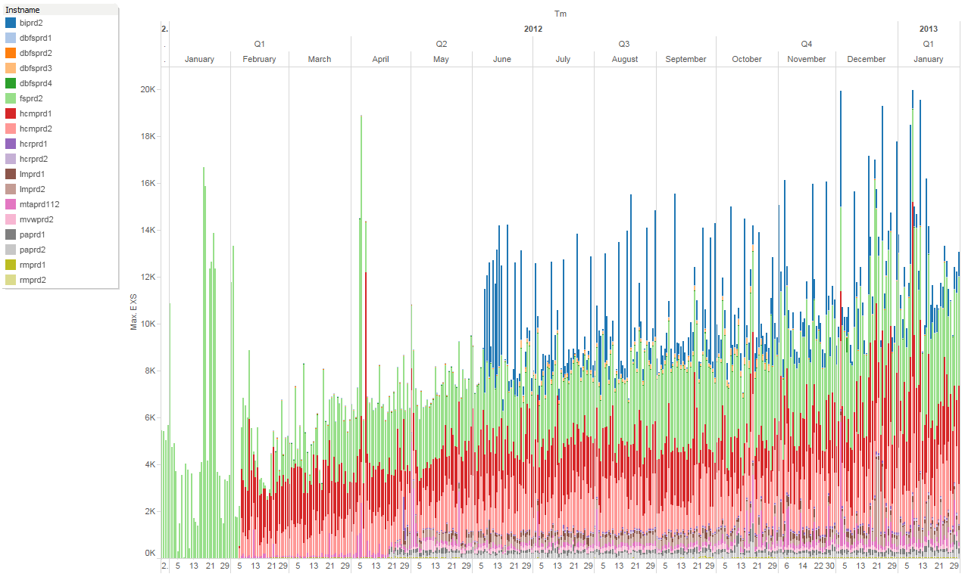
~20K exec/sec on X2-2 ½ rack
Notes:
20K exec/sec on a X2-2 ½ rack is pretty good. I’ve seen environments do 20K exec/sec but they are running on a big iron machine like M9000 and only holding 1 critical OLTP database.

Slide 8
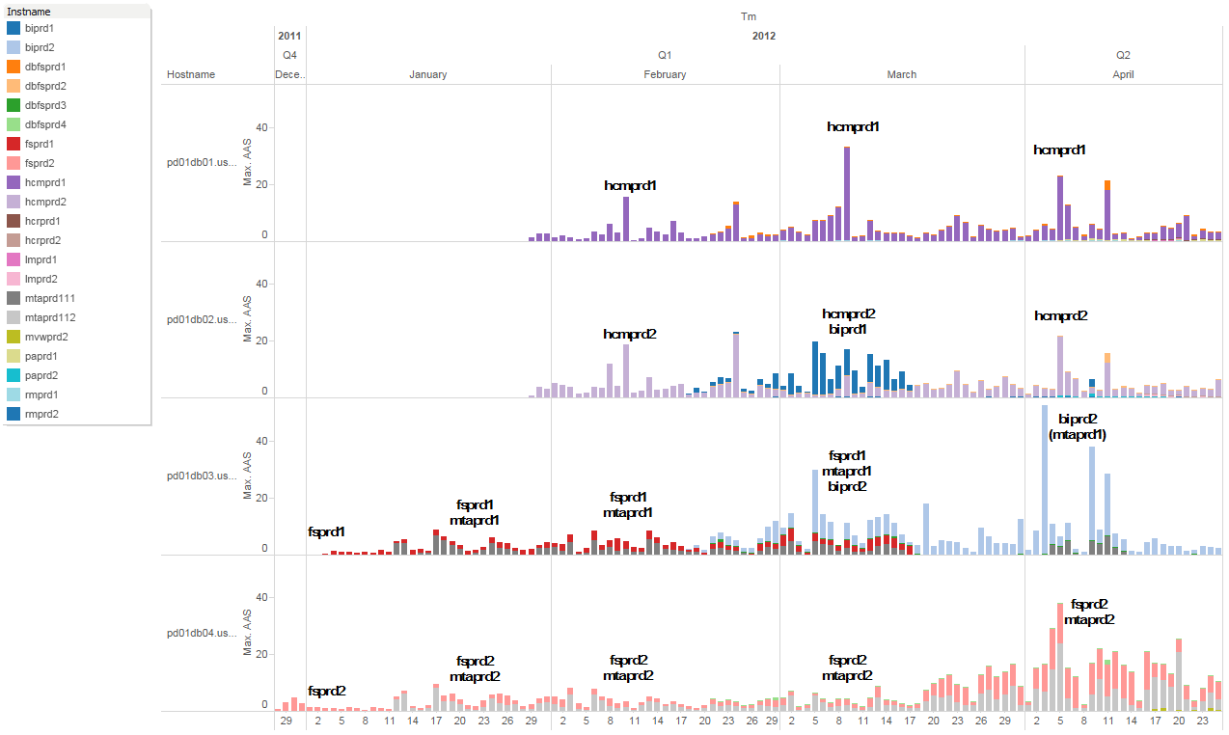
Workload Management is still important
1 DB
2 DBs
3 DBs
4 DBs
workload contention!
4 DBs
node layout
adjusted
Notes:
Exadata still have limited capacity in terms of compute power. This is critical for CPU intensive workloads like the HCM and some BI/DW jobs.
On the graph we made the node3 dedicated to just the DW database. Nodes 1 and 2 for HCM because it’s super critical. And the node4 for FS and MTA. Optionally we can make use of node3 for MTA if it needs compute power. The small DBs are spread out across nodes 1,2, and 4. The key here is knowing your workload by having a clear visualization to justify the workload management decisions.

Slide 9
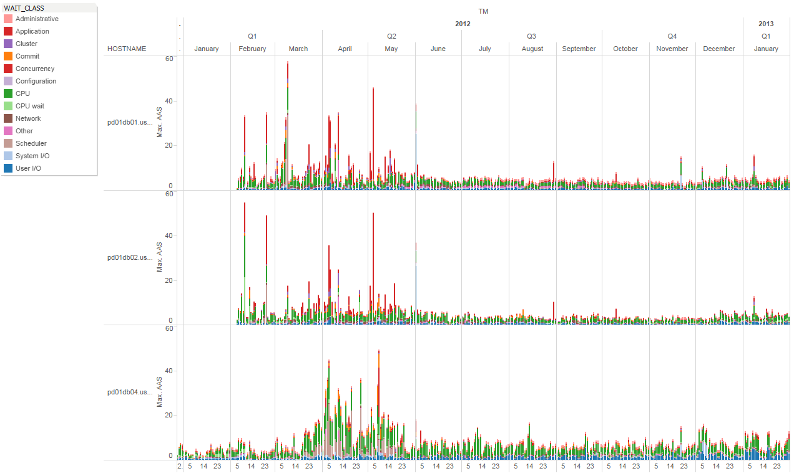
Tuning and Stabilization
SQL, config, app issues
Tuned state
Notes:
Peoplesoft on Exadata still needs tuning and stabilization

Slide 10
End

